Slide 1

Software Architecture Evaluation & Methods Comparison
Prepared by,
Chengyuan Zhang
Gary Chiu
Matthew Dudycz
Vatsal Shah
Wang Lyu
Western University
SOFTWARE DESIGN & ARCHITECTURE

Slide 2
Agenda
Basic Reason for Evaluation
Goals of an architectural assessment
When do we Evaluate?
Benefits of Evaluation of Software Architecture
What is after the architectural evaluation?
Architecture evaluation methods with examples
SAAM + Example
ATAM + Example
ALMA + Example
PASA + Example
Comparison
Vatsal Shah

Slide 3
Basic Reason for Evaluation
Architecture is so vital for the success of any system,
assess and evaluate it
identify flaws and risks early
mitigate those risks before the costs become too high to manage effectively
House Analogy
Spend extra time on blueprint, then proceed to build if blueprint is perfect
Vatsal Shah
Notes:
So to set the context for this presentation, we want to talk about why architecture evaluation is important.
The architecture of a system is vital for the its success, so we need ways to assess and evaluate architectures, identity flaws and risks, and mitigate those risks before the costs become too high to manage effectively.
The earlier you find a problem in a software project, the better off you are. The cost to fix an error found during requirements or early design phases is orders of magnitudes less to correct than the same error found during testing. Architecture is the product of the early design phase, and its effect on the system and the project is profound.
An unsuitable architecture will precipitate disaster on a project. Performance goals will not be met. Security goals will fall by the wayside. The customer will grow impatient because the right functionality is not available, and the system is too hard to change to add it. Schedules and budgets will be blown out of the water as the team scrambles to back-fit and hack their way through the problems
if you were building a house, you wouldn't think of proceeding without carefully looking at the blueprints before construction began. You would happily spend the small amount of extra time because you know it's much better to discover a missing bedroom while the architecture is just a blueprint, rather than on moving day

Slide 4
Goals of an architectural assessment
In a perfect scenario, business goals, also known as quality attributes, should be utilized to identify and prioritize requirements.
Collect quality attributes of the system by merging:
the requirements document
the plans of the project manager.
Vatsal Shah

Slide 5
When do we Evaluate?
As early as possible, even during actual development of SA
The earlier problems are found, the earlier and cheaper they can be fixed
Certainly after the architecture is completed, you should validate it before development
Later to ensure consistency between design and implementation especially for legacy systems
Before acquiring a new system.
The real answer is early and often!
Vatsal Shah

Slide 6
Benefits of Evaluation of Software Architecture
Forced Preparation for the review
Presenters will focus on clarity
Captured Rationale
Evaluation will focus on questions
Answering yields “explanations of design decisions”
Useful throughout the software life cycle
After the fact capturing rationale much more difficult “why was that done?”
Early detection of problems with the architecture
Validation of requirements
Discussion of how well a requirement is met opens discussion
Some requirements easy to demand, hard to satisfy
Improved architectures
Vatsal Shah
Source: [Hamda Ebrahim2,2015 - (2) ]

Slide 7
What is after the architectural evaluation?
We should:
Know whether the current architecture is suitable for achieving the quality attributes of the system
get a list of suggested changes for achieving the quality attributes of the system.
Get a list of the quality attributes which you will achieve fully and those you will only partially achieve.
Get a list of quality attributes that have associated risks.
Gain a better understanding of the architecture
Vatsal Shah

Slide 8
Architecture evaluation methods
SAAM - Software Architecture Analysis Method
ATAM - Architecture Trade-off Analysis Method
ALMA - Architecture Level Modifiability Analysis
PASA - Performance Assessment of Software Architecture
Vatsal Shah

Slide 9
Architecture evaluation methods
SAAM - Software Architecture Analysis Method
ATAM - Architecture Trade-off Analysis Method
ALMA - Architecture Level Modifiability Analysis
PASA - Performance Assessment of Software Architecture

Slide 10
Software Architecture Analysis Method (SAAM)
Scenario-based method to evaluate architecture
Determines how specific application quality attributes are achieved and how possible changes in the future will affect quality attributes
Useful for quickly assessing many quality attributes such as modifiability, portability, extensibility, and integrability
Precursor to ATAM (Architecture Trade-Off Analysis Method)
Gary Chiu
Notes:
based on hypothetical cases studies and scenarios

Slide 11
Software Architecture Analysis Method (SAAM) Steps
Develop Scenarios
Capture all major uses, quality attributes, and foreseeable future changes
Describe Architecture(s)
Create static representation of system
Classify and Prioritize Scenarios
Classify as direct scenario (system supports) or indirect scenario (system would need modifications to support)
Vote to prioritize
Gary Chiu
Notes:
based on hypothetical cases studies and scenarios
1. Brainstorm activities that the system must support, In developing scenarios the challenge is to capture all major uses and users of the system, all quality attributes and their associated level that the system must reach and most important all foreseeable future changes to the system.
2. Static representation: (components, connectors), This can take the form of a natural-language specification of the overall behavior or some other more formal specification.

Slide 12
Software Architecture Analysis Method (SAAM) Steps
Individually Evaluate Indirect Scenarios
Describe changes required to accomodate indirect scenarios
Identify impacted system components, estimated costs and efforts
Assess Scenario Interaction
Scenarios interact if changes are requested to the same component(s)
Modify or divide into sub-components to avoid interaction
Create Overall Evaluation
Assign weight to each scenario based on importance
Propose and evaluate alternative architectures
Gary Chiu
Notes:
4. In case of a direct scenario the architect demonstrates how the scenario would be executed by the architecture. In case of an indirect scenario the architect describes how the architecture would need to be changed to accommodate the scenario. For each indirect scenario there must be identified the architectural modifications needed to facilitate that scenario together with the impacted and/or new system’s components and the estimated cost and effort to implement the modification.
5. When two or more scenarios are requesting changes over the same component(s) of the architecture, they are said to interact. In this case, the affected components need to be modified or divided into sub-components in order to avoid of the interaction of the different scenarios.
6. Finally a weight is assigned to each scenario in terms of its relative importance to the success of the system. The weighting ties back to the business goals supported by a scenario or other criteria like costs, risks, time to market, and so on. Based on this scenario weighting can be proposed an overall ranking if multiple architecture are compared. Alternatives for the most suitable architecture can be proposed, covering the direct scenarios and requiring least changes in supporting the indirect scenarios.

Slide 13
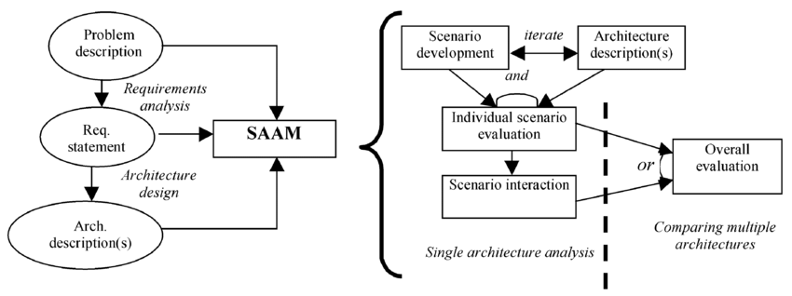
Software Architecture Analysis Method (SAAM) Diagram
Gary Chiu
Source: [Liliana Dobrica - (10) ]
Notes:
The SAAM method require two types of input:
Inputs:
A description of the architectural design or a set of design that are under analysis and evaluation.
The quality requirements that the system is intended to achieve.

Slide 14
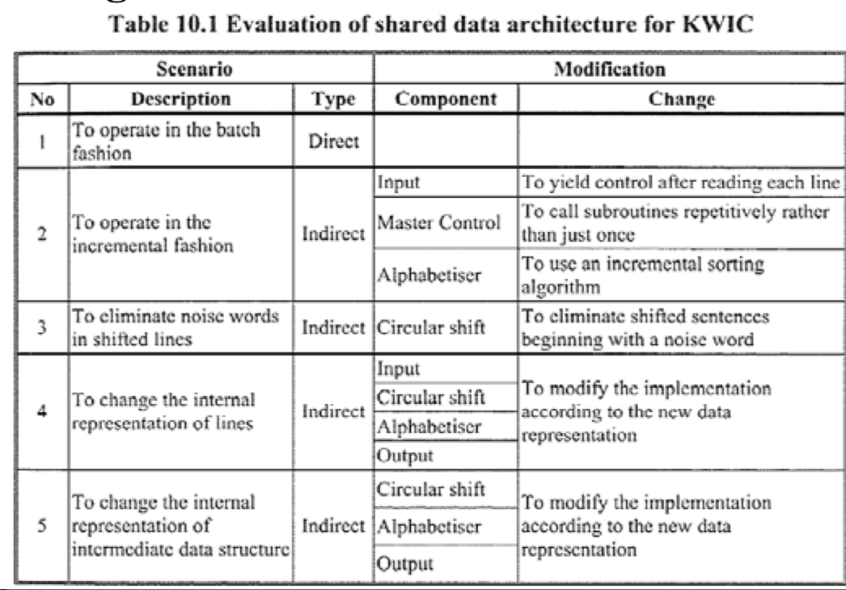
Example: Software Architecture Analysis Method (SAAM)
Step 4: Individually evaluate Scenarios
KWIC: Keyword-in- Context Indexing System
Gary Chiu
Source: [Peter Lo- (09) ]
Notes:
KWIC:
Keyword in Context Indexing system
Accepts ordered sequence of text as input -- each line is an ordered sequence of words, each word is an ordered sequence of characters
Outputs all the circular shifts of all the lines in alphabetic order
Example:
Input: Sequence of lines
An introduction to software architecture
Key word in context
An introduction to software architecture
Architecture an introduction to software
Context key word in
In context key word
Introduction to software architecture an
Key word in context
Software architecture an introduction to
To software architecture an introduction
Word in context key

Slide 15
Architecture evaluation methods
SAAM - Software Architecture Analysis Method
ATAM - Architecture Trade-off Analysis Method
ALMA - Architecture Level Modifiability Analysis
PASA - Performance Assessment of Software Architecture
Vatsal Shah

Slide 16
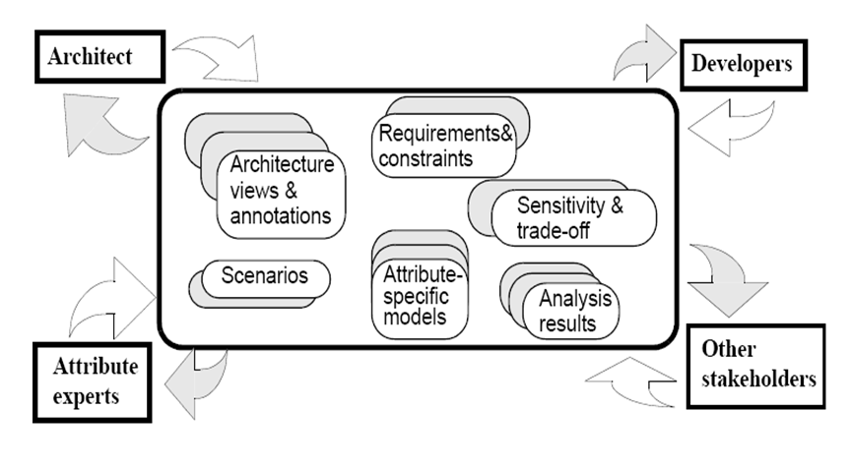
Architecture Trade-off Analysis Method (ATAM)
ATAM is a scenario-based architecture method for assessing quality attributes such as: modifiability, portability, Variability, and Functionality
ATAM aims to promote disciplined reasoning for analysing a SA’s capability with respect to multiple quality attributes. It also helps make trade-offs between competing attributes
ATAM is optimized upon Software Architecture Analysis Method (SAAM).
Wang LYU
Source: [Hamda Ebrahim2,2015 - (2) ]
Notes:
Architecture Trade-off analysis method or ATAM is a scenario-based architecture method that aims at assessing the consequences of architectural decisions in light of quality attribute requirements. Other than assessment, it also contributes to making trade-offs between competing attributes. In essense, ATAM is an optimized version of SAAM.

Slide 17
Architecture Trade-off Analysis Method (ATAM)
ATAM calls for the participation and cooperation of three separated groups of people:
The evaluation team: outsiders
Project decision makers: project manager, customers who invest on the development,architect.
Architecture stakeholders: developers, testers, integrators, maintainers, performance engineers, users
Wang LYU

Slide 18
Architecture Trade-off Analysis Method (ATAM)
ATAM consists of four phases:
Phase 0: Partnership and Preparation.
Project representatives brief evaluators about the project
Evaluation team examines architecture document to gain an understanding of the architecture and methods involved.
Phase 1-2: Evaluation
Evaluation team begin info gathering and analysis (Phase 1)
Architecture’s stakeholders join (Phase 2)
Phase 3: Follow-up
Evaluation team delivers a final report which is proofread by architecture’s stakeholders.
Wang LYU
Notes:
ATAM divides the evaluation procedure into four separated phases. In phase 0, project representative help bring the evaluation team up to speed, briefing them on the project. After that, the evaluation procedure moves to the core parts which are Phase 1 and 2. During these two phases, evaluation kicks off. At this point, the evaluation team grasp the whole idea of the project, architecture and quality attributes. They start collecting other info, like quality attribute scenarios and their corresponding priority. ATAM uses these scenarios as basis for evaluating architectures. In the final phase, the evaluation team would deliver a final report which is proofread by the stakeholders.

Slide 19
Architecture Trade-off Analysis Method (ATAM)
The Output of ATAM:
A set of risks and nonrisks.
Risks: architectural decisions that would lead to undesired consequences.
Nonrisks: architectural decisions that are deemed saft.
A set of risk themes
Evaluation team examines the found risks to find the overarching themes that unveil the systematic weakness of the architecture.
A set of identified sensitivity and tradeoff points
Wang LYU
Notes:
The identified risks form the basis for an architectural risk mitigation plan.
Risks, sensitivity points, and tradeoff points are areas of potential future concern with the architecture. These areas can be made the focus of future effort in terms of prototyping, design, and analysis.

Slide 20
Architecture evaluation methods
SAAM - Software Architecture Analysis Method
ATAM - Architecture Trade-off Analysis Method
ALMA - Architecture Level Modifiability Analysis
PASA - Performance Assessment of Software Architecture
Vatsal Shah

Slide 21
Architecture Level Modifiability Analysis (ALMA)
Developed around goal-oriented evaluation
Goal setting is the most important aspect to facilitate other steps
Intended to address modifiability issues:
Maintenance cost prediction
Risk assessment
SA selection
Typically used before settling on an SA, but can be used to develop legacy systems
Matthew Dudycz

Slide 22
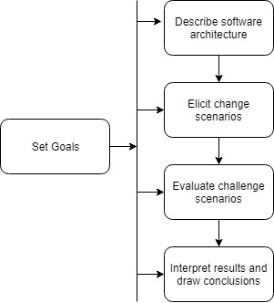
Architecture Level Modifiability Analysis (ALMA)
Fixed structure of five steps
Differs from SAAM as it does not address the need for differences in techniques
Matthew Dudycz
Source: [Lassing, 2002- (07) ]

Slide 23
Architecture Level Modifiability Analysis (ALMA)
Set the goal to determine the type of results and techniques
Consults with development team on architecture
Capture events stakeholders anticipate in the future and their likelihood
Determine the effect on the system
Review collected analysis for results
Matthew Dudycz
Source: [Lassing, 2002- (07) ]

Slide 24
Example: Architecture Level Modifiability Analysis (ALMA)
Define a goal of maintenance cost prediction based on developer stakeholder needs for budget estimations
Based on view documentation, estimate the size of the architecture
Development of change scenarios, such as the adapting to environment updates of the system
Examine potential modifications to existing components based on this change
Based on the collected information, estimate the amount of work required for maintenance over the coming period
Matthew Dudycz

Slide 25
Performance Assessment of Software Architecture (PASA)
Goal
assess the capability of candidate Software Architectures with respect to performance objectives of a System
Focus
Performance related scenarios
Other quality attributes (e.g. maintainability)
Trade-offs between them
Domain
Web-based Systems
Embedded Systems
Real-time Systems
Financial
Chengyuan Zhang
Source: [R. Kazman, 1999 - (03) ]

Slide 26
Architecture evaluation methods
SAAM - Software Architecture Analysis Method
ATAM - Architecture Trade-off Analysis Method
ALMA - Architecture Level Modifiability Analysis
PASA - Performance Assessment of Software Architecture
Vatsal Shah

Slide 27
Performance Assessment of Software Architecture (PASA)
Goal
assess the capability of candidate Software Architectures with respect to performance objectives of a System
Focus
Performance related scenarios
Other quality attributes (e.g. maintainability)
Trade-offs between them
Domain
Web-based Systems
Embedded Systems
Real-time Systems
Financial
Chengyuan Zhang
Source: [R. Kazman, 1999 - (03) ]

Slide 28
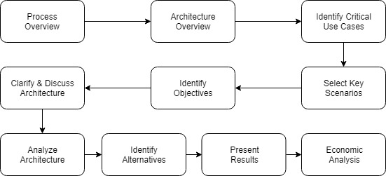
The process model of PASA
Chengyuan Zhang
Source: [Muhammad Ali Babar,2004 - (6)]
Notes:
The evaluation starts with a process presentation, a high-level overview will be shown in next step. For these two steps, if the document has not been recorded in SA, it should be documented. The evaluation team works with the developers to select key scenarios and need to be documented using UML. The next step is aimed at identifying architectural styles or patterns used in the SA.This method incorporates both qualitative and quantitative techniques to illustrate the potential risks that may be inherent in a SA.

Slide 29
Example: Performance Assessment of Software Architecture (PASA)
Take the final project for example
Arrange an evaluation group including either members of the project or other people
Give the presentation about the overview of the software architecture and offer the documents arranged during the period of designing the architecture
Offer the comprehensive test cases or user cases to the evaluation group
Identify other quality attributes in the architecture like useability and scalability
Deliver the preparation documents to the final evaluation group and start to give a detailed analysis
At the same time, find out the alternative strategies and give an overall comparison
Present the results or give the official documents
Chengyuan Zhang

Slide 30
Comparison of SA Evaluation Methods
Vatsal Shah

Slide 31
Method | Main Objective | Assessed Quality | Strengths | Weakness | System Type applicable for | Addressed QAs
SAAM | Architectural suitability and Risks analysis | Modifiability | Good for evaluating the evolution of the system through scenarios, Identifies areas of high complexity | Not as detailed as ATAM (utility tree, architecture approaches, etc.) | All | Mainly modifiability but can be adapted for Others
ATAM | Sensitivity and tradeoff analysis | Modifiability | Scenarios generation based on Requirements, Applicable for static and dynamic properties, Quality utility tree | Requires detailed technical knowledge | All | Multiple QAs
ALMA | Maintenance cost prediction, Risk assessment, architectures comparison | Modifiability | Scenario generation stopping criterion | Restricted set of case studies and concentrates on static properties | Business information systems | Reusability
PASA | Runtime quality attributes, Capability | Performance | Available for multiple lifecycle of the software, usage of both qualitative and quantitative techniques | Overlook the modifiability and other quality attributes | Web-based System, Embedded System
Vatsal Shah
Source: [P. Shanmugapriya, 2012- (04), Muhammad Ali Babar = (06) ]

Slide 32
Logical partitioning of the work
Chengyuan Zhang
PASA
Process model of PASA
A simple flow of PASA
Gary Chiu
SAAM -- Overview, Steps, Diagram, Example, Pros/Cons
Basic Reason for Evaluation
Matthew Dudycz
ALMA
Process and breakdown
Specialization of method
Vatsal Shah

Slide 33
Continue...
Vatsal Shah
Set the flow of a topic presentation
Introduction, Importance of architecture evaluation
Study & Comparison with presented architecture methods
Wang Lyu
Study ATAM evaluation method
ATAM participants, basic phases introduction
ATAM core workflow introduction
Vatsal Shah

Slide 34
References
“Software Architecture in Practice”, Len Bass, Paul Clements, Rick Kazman (Chapter 21)
“Software architecture evaluation” by Hamda Ebrahim.Ebtsam abd el-Hakam. (Link)
“Evaluating Software Architectures for Real-Time Systems” by R. Kazman, M. Klein, P. Clements - Carnegie Mellon University date: July, 1999 (Link)
“Software Architecture Evaluation Methods – A survey” by P. Shanmugapriya and R. M. Suresh - International Journal of Computer Applications (0975 – 8887) Volume 49– No.16, July 2012 (Link)
“Evaluating a Software Architecture” By Desalegn Bekele. (Link)
“Comparison of Scenario-Based Software Architecture Evaluation Methods” by Muhammad Ali Babar, Ian Gorton. (Link)
“Experiences with ALMA: Architecture-Level Modifiability Analysis.” Lassing, Nico, et al. Journal of Systems and Software, vol. 61, no. 1, Mar. 2002, pp. 47–57., doi:10.1016/s0164-1212(01)00113-3. (Link)
“Scenario-Based Software Architecture Evaluation Methods: An Overview” by Mugurel T. Ionita, Dieter K. Hammer, Henk Obbink from
“Software Architecture Analysis Method (SAAM) - Lecture 7A” by Peter Lo, U08182: Information System Design (Link)
“A survey on software architecture analysis methods” by Liliana Dobrica, Polytechnic University of Bucharest.(Link)

Slide 35
THANK YOU

